Slide 1
An introduction to sentiment analysis and opinion mining
Bettina Berendt
Department of Computer Science
KU Leuven, Belgium
http://people.cs.kuleuven.be/~bettina.berendt/
Vienna Summer School on Digital Humanities
July 7th, 2015, Vienna, Austria

Slide 2
Goals and non-goals
Goals
Understand the basic ideas of sentiment analysis
Understand how computer-scientist text miners approach “sentiment“ and “opinion“
Time permitting: Learn how different disciplines view these two concepts
Learn about some pitfalls and encourage a critical view
Get your hands on some tools and real data
Since this field is more involved than basic text mining, we will remain at a high level
Have pointers for inquiring and going further
Non-goals (selection)
the statistical background of methods
A comprehensive overview of the state-of-the-art of sentiment analysis methods
(See the surveys in the references for this)
A comprehensive overview of the state-of-the-art of sentiment analysis applications in the digital humanities or social or behavioural sciences

Slide 3
Motivation and overview Major dimensions: Units of analysis, methods, features Issues in aspect-/sentence-oriented SA Social media: the case of tweets Evaluation Some challenges and current research directions

Slide 4
Motivation and overview (you use it already) Major dimensions: Units of analysis, methods, features Issues in aspect-/sentence-oriented SA Social media: the case of tweets Evaluation Some challenges and current research directions

Slide 5
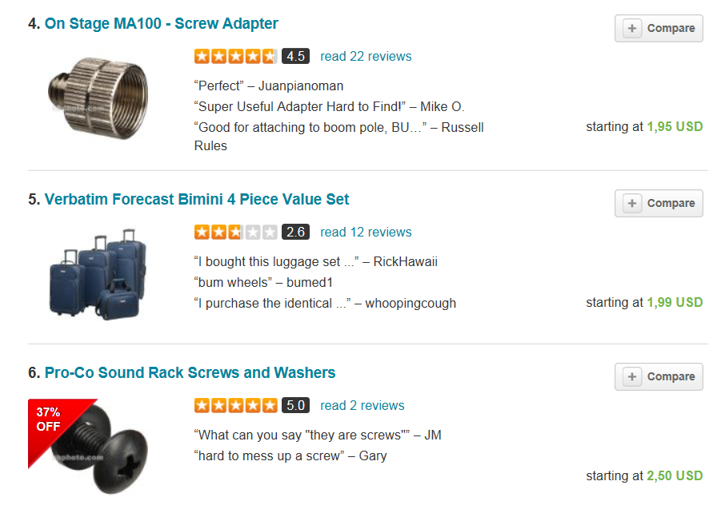
Meet sentiment analysis (1) (buzzilions.com)
Notes:
? Should I show Bing Liu‘s slide on aggregation?

Slide 6
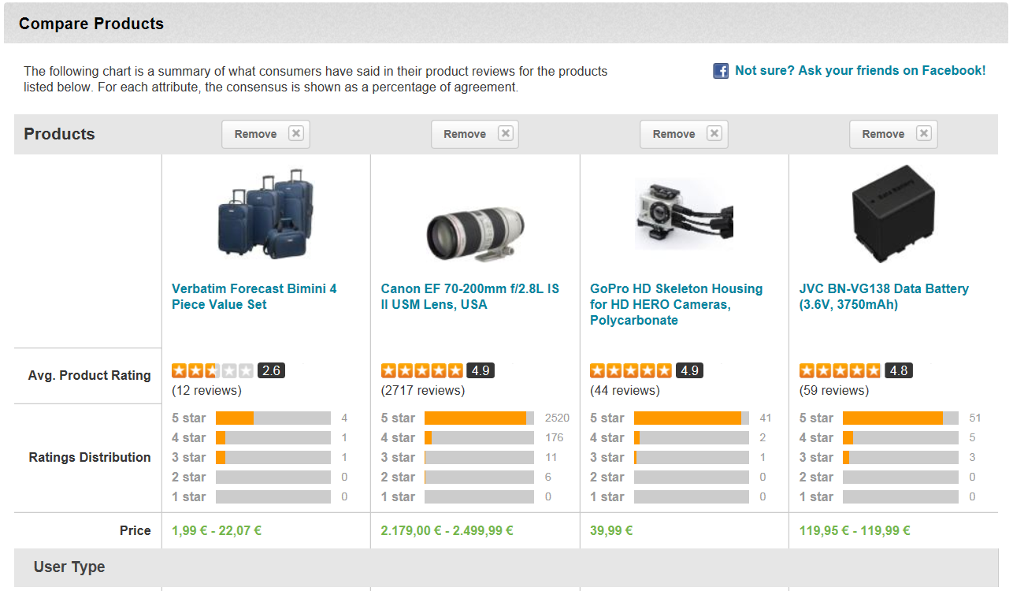
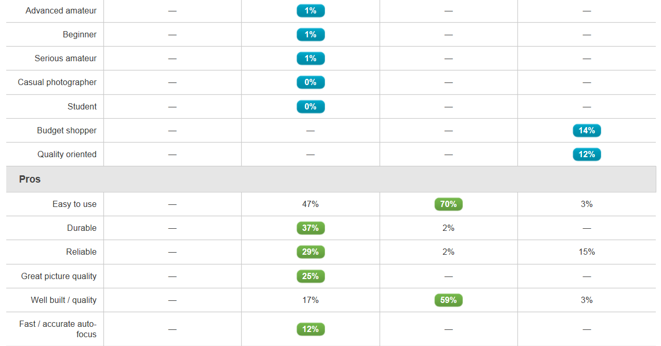
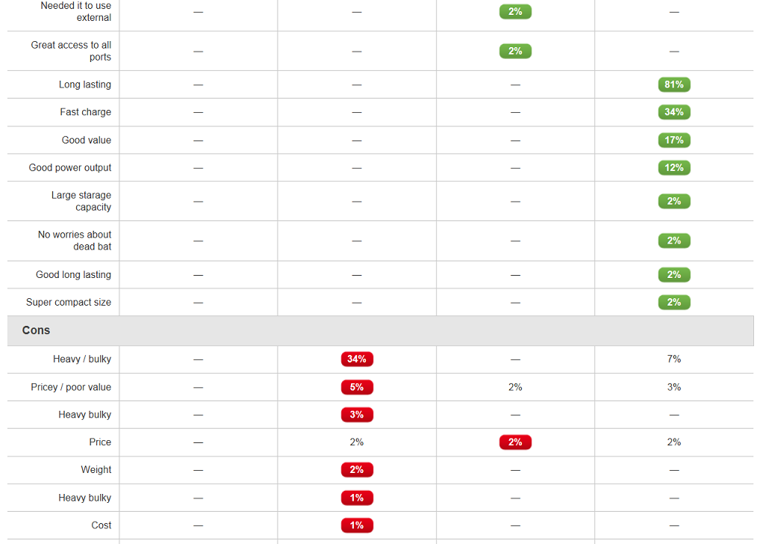
Aggregations (buzzilions.com)
Notes:
Das erste kann man benutzen für social search Einstieg! (ask your friends)

Slide 7
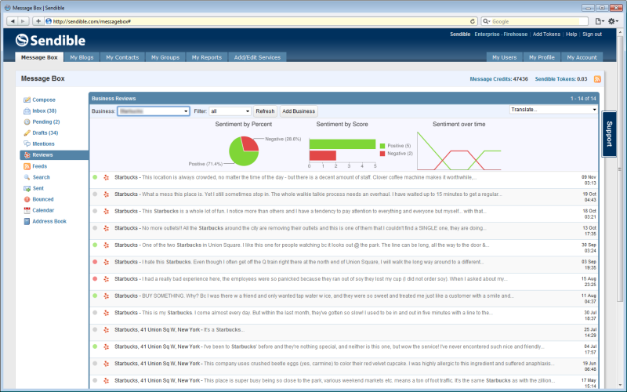
Meet sentiment analysis (2)
Notes:
http://sendible.com/features/review-monitoring

Slide 8
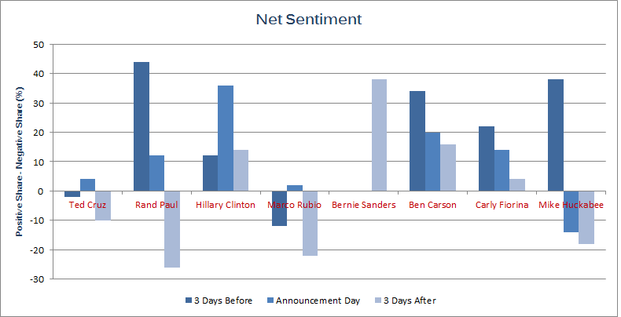
Meet sentiment analysis (3)
Notes:
http://www.epolitics.com/2015/05/28/internet-loves-hillary-clinton-hates-huckabee-gave-cruz-a-first-mover-boost/

Slide 9
What would you want to use SA for?

Slide 10
A field of study with many names
Opinion mining
Sentiment analysis
Sentiment mining
Subjectivity detection
...
Often used synonymously
Some shadings in meaning
“sentiment analysis“ describes the current mainstream task best ➔ I‘ll use this term.

Slide 11
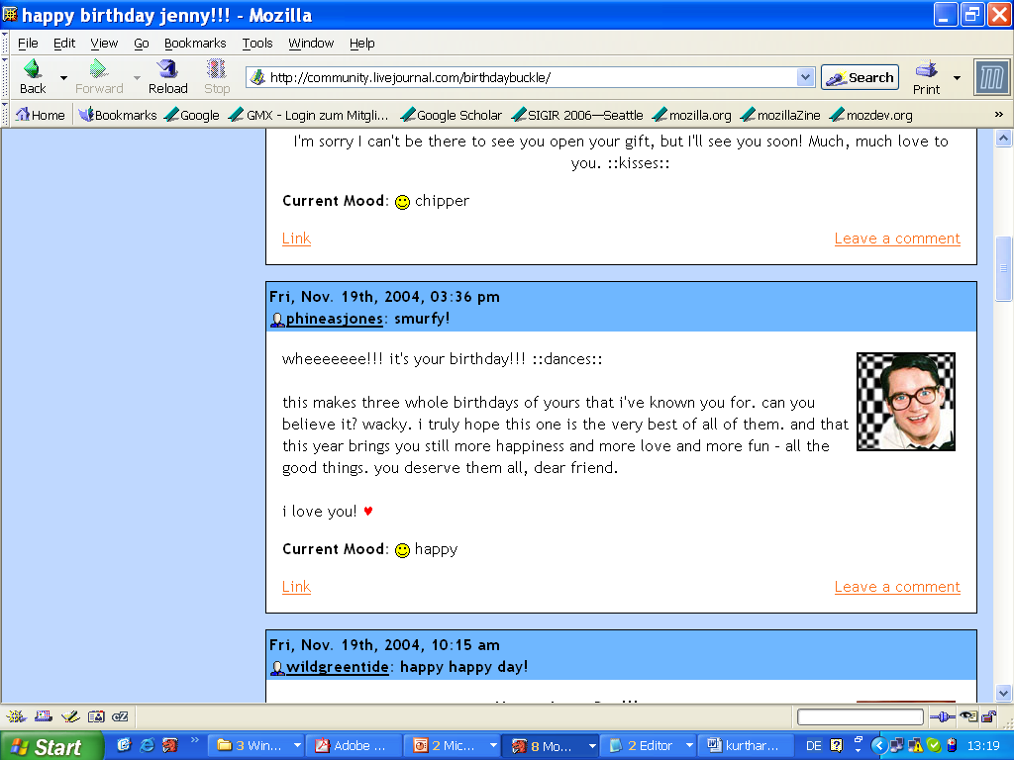
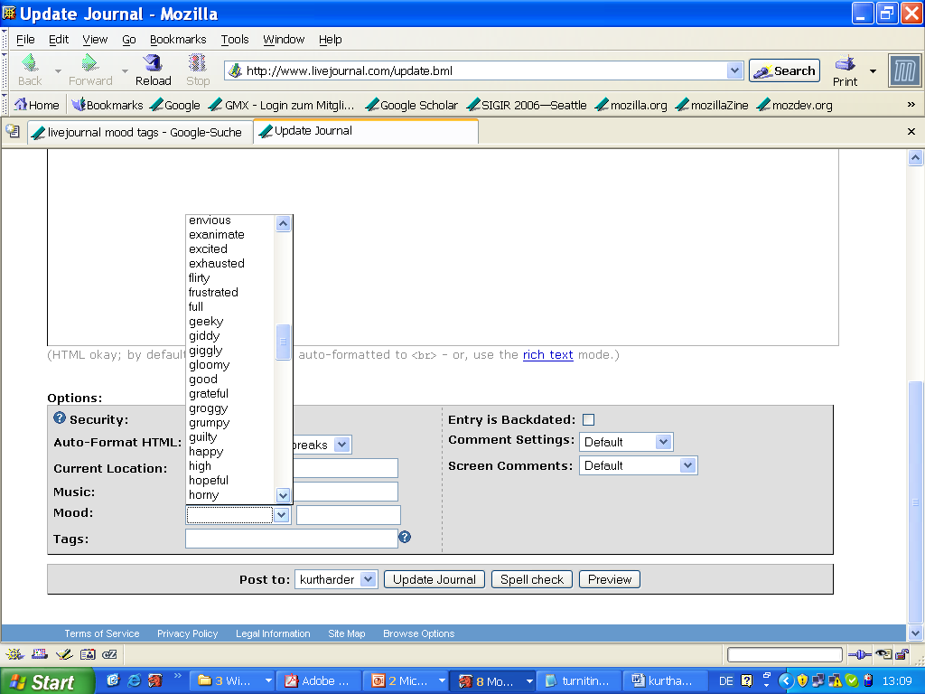
Happiness in blogosphere. Or: document-oriented sentiment analysis
Notes:
http://members.iinet.net.au/~sauterp@iinet.net.au/funny/smiley.gif

Slide 12
Aspect-oriented sentiment analysis: It‘s not ALL good or bad
Yesterday, I bought a Nokia phone and my girlfriend bought a moto phone. We called each other when we got home. The voice on my phone was not clear. The camera was good. My girlfriend said the sound of her phone was clear. I wanted a phone with good voice quality. So I was satisfied and returned the phone to BestBuy yesterday.
Small phone – small battery life.

Slide 13
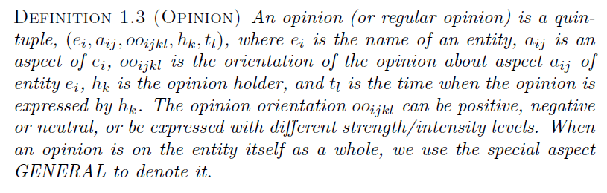
Liu & Zhang‘s (2012) definition
DEFINITION 1.3‘ (SENTIMENT-OPINION) A sentiment-opinion is a quin-
Notes:
p.4
Bing Liu, Lei Zhang: A Survey of Opinion Mining and Sentiment Analysis. Mining Text Data 2012: 415-463

Slide 14
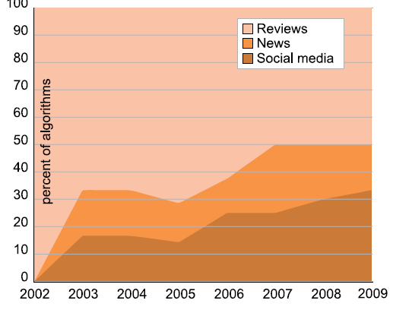
Data sources
Review sites
Blogs
News
Microblogs
From Tsytsarau & Palpanas (2012)

Slide 15
Motivation and overview Major dimensions: Units of analysis, methods, features Issues in aspect-/sentence-oriented SA Social media: the case of tweets Evaluation Some challenges and current research directions

Slide 16
The unit of analysis
community
another person
user / author
document
sentence or clause
aspect (e.g. product feature)
“What makes people happy“ example
Phone example
Notes:
TODO: hiervon werden einige besprochen, andere nicht -> markieren oder später drauf zurückkommen

Slide 17
The analysis method
Machine learning
Supervised
Unsupervised
Lexicon-based
Dictionary
Flat
With semantics
Corpus
Discourse analysis
“What makes people happy“ example
“What makes people happy“ example
Phone example
Phone example

Slide 18
Features
Features:
words (bag-of-words)
n-grams
parts-of-speech (e.g. Adjectives and adjective-adverb combinations)
opinion words (lexicon-based: dictionary or corpus)
valence intensifiers and shifters (for negation); modal verbs; ...
syntactic dependency
Feature selection based on
frequency
information gain
odds ratio (for binary-class models)
mutual information
Feature weighting
term presence or term frequency
inverse document frequency (→ TF.IDF)
term position : e.g. title, first and last sentence(s)

Slide 19
Motivation and overview Major dimensions: Units of analysis, methods, features Issues in aspect-/sentence-oriented SA Social media: the case of tweets Evaluation Some challenges and current research directions

Slide 20
Objects, aspects, opinions (1)
Yesterday, I bought a Nokia phone and my girlfriend bought a moto phone. We called each other when we got home. The voice on my phone was not clear. The camera was good. My girlfriend said the sound of her phone was clear. I wanted a phone with good voice quality. So I was satisfied and returned the phone to BestBuy yesterday.
Small phone – small battery life.
Object identification

Slide 21
Objects, aspects, opinions (2)
Yesterday, I bought a Nokia phone and my girlfriend bought a moto phone. We called each other when we got home. The voice on my phone was not clear. The camera was good. My girlfriend said the sound of her phone was clear. I wanted a phone with good voice quality. So I was satisfied and returned the phone to BestBuy yesterday.
Small phone – small battery life.
Object identification
Aspect extraction

Slide 22
Find only the aspects belonging to the high-level object
Basic idea: POS and co-occurrence
find frequent nouns / noun phrases
find the opinion words associated with them (from a dictionary: e.g. for positive good, clear, amazing)
Find infrequent nouns co-occurring with these opinion words
BUT: may find opinions on aspects of other things
Improvements on the basic method exist
Notes:
Popescu, A. and O. Etzioni. Extracting product features and opin-
ions from reviews. In Proceedings of Conference on Empirical Meth-
ods in Natural Language Processing (EMNLP-2005), 2005.

Slide 23
Objects, aspects, opinions (3)
Yesterday, I bought a Nokia phone and my girlfriend bought a moto phone. We called each other when we got home. The voice on my phone was not clear. The camera was good. My girlfriend said the sound of her phone was clear. I wanted a phone with good voice quality. So I was satisfied and returned the phone to BestBuy yesterday.
Small phone – small battery life.
Object identification
Aspect extraction
Grouping synonyms

Slide 24
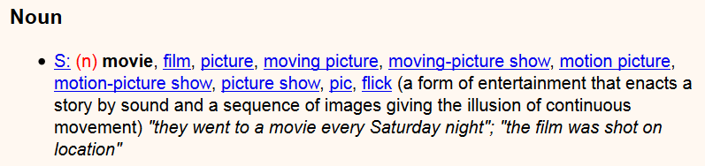
Grouping synonyms
General-purpose lexical resources provide synonym links
E.g. Wordnet
But: domain-dependent:
Movie reviews: movie ~ picture
Camera reviews: movie → video; picture → photos
Carenini et al (2005): extend dictionary using the corpus
Input: taxonomy of aspects for a domain
similarity metrics defined using string similarity, synonyms and distances measured using WordNet
merge each discovered aspect expression to an aspect node in the taxonomy.
Notes:
Carenini, G., R. Ng, and E. Zwart. Extracting knowledge from eval-
uative text. In Proceedings of Third Intl. Conf. on Knowledge Cap-
ture (K-CAP-05), 2005.

Slide 25
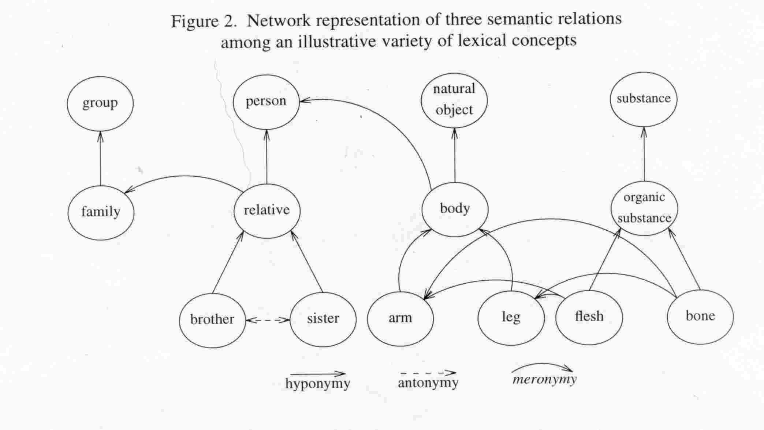
WordNet
Notes:
http://www-rohan.sdsu.edu/~ling354/nounnet.jpg

Slide 26
Objects, aspects, opinions (4a)
Yesterday, I bought a Nokia phone and my girlfriend bought a moto phone. We called each other when we got home. The voice on my phone was not clear. The camera was good. My girlfriend said the sound of her phone was clear. I wanted a phone with good voice quality. So I was satisfied and returned the phone to BestBuy yesterday.
Small phone – small battery life.
Object identification
Aspect extraction
Grouping synonyms
Opinion orientation classification

Slide 27
Objects, aspects, opinions (4b)
Yesterday, I bought a Nokia phone and my girlfriend bought a moto phone. We called each other when we got home. The voice on my phone was not clear. The camera was good. My girlfriend said the sound of her phone was clear. I wanted a phone with good voice quality. So I was satisfied and returned the phone to BestBuy yesterday.
Small phone – small battery life.
Object identification
Aspect extraction
Grouping synonyms
Opinion orientation classification

Slide 28
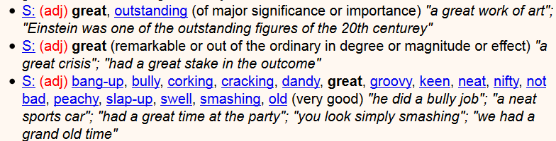
Opinion orientation
Start from lexicon
E.g. dictionary SentiWordNet
Assign +1/-1 to opinion words, change according to valence shifters (e.g. negation: not etc.)
But clauses (“the pictures are good, but the battery life ...“)
Dictionary-based: Use semantic relations (e.g. synonyms, antonyms)
Corpus-based:
learn from labelled examples
Disadvantage: need these (expensive!)
Advantage: domain dependence
Notes:
Researchers have also used additional information (e.g.,
glosses) in WordNet and additional techniques (e.g., machine learning)
to generate better lists [1, 19, 20, 45]. Several opinion word lists have
been produced [17, 21, 31, 90, 104].
21 = SentiWordNet

Slide 29
Objects, aspects, opinions (5)
Yesterday, I bought a Nokia phone and my girlfriend bought a moto phone. We called each other when we got home. The voice on my phone was not clear. The camera was good. My girlfriend said the sound of her phone was clear. I wanted a phone with good voice quality. So I was satisfied and returned the phone to BestBuy yesterday.
Small phone – small battery life.
Object identification
Aspect extraction
Grouping synonyms
Opinion orientation classification
Integration / coreference resolution

Slide 30
Not all sentences/clauses carry sentiment
Yesterday, I bought a Nokia phone and my girlfriend bought a moto phone. We called each other when we got home. The voice on my phone was not clear. The camera was good. My girlfriend said the sound of her phone was clear. I wanted a phone with good voice quality. So I was satisfied and returned the phone to BestBuy yesterday.
Small phone – small battery life.
Neutral sentiment

Slide 31
Subjectivity detection
2-stage process:
Classify as subjective or not
Determine polarity
A problem similar to genre analysis
e.g. Naive Bayes classifier on Wall Street Journal texts: News and Business vs. Letters to the Editor – 97% accuracy (Yu & Hatzivassiloglou, 2003)
But a much more difficult problem! (Mihalcea et al., 2007)
Overview in Wiebe et al. (2004)
Notes:
J. M. Wiebe, T. Wilson, R. Bruce, M. Bell, and M. Martin, “Learning subjective
language,” Computational Linguistics, vol. 30, pp. 277–308, September
2004.
307: J. Wiebe and R. Mihalcea, “Word sense and subjectivity,” in Proceedings of
the Conference on Computational Linguistics / Association for Computational
Linguistics (COLING/ACL), 2006.
---
[326] H. Yu and V. Hatzivassiloglou, “Towards answering opinion questions: Separating
facts from opinions and identifying the polarity of opinion sentences,”
in Proceedings of the Conference on Empirical Methods in Natural Language
Processing (EMNLP), 2003.

Slide 32
Motivation and overview Major dimensions: Units of analysis, methods, features Issues in aspect-/sentence-oriented SA Social media: the case of tweets Evaluation Some challenges and current research directions

Slide 33
Special challenges in Tweets
Very popular data source
Mostly public messages
API
But: opaque sampling (“the best 1%“)
Vocabulary, grammar, ...
Length restriction
Semantic enrichment
Hyperlinked context
Thread context
Social-network context
Notes:
TODO ??? Is semantic enrichment done for opinion mining?

Slide 34
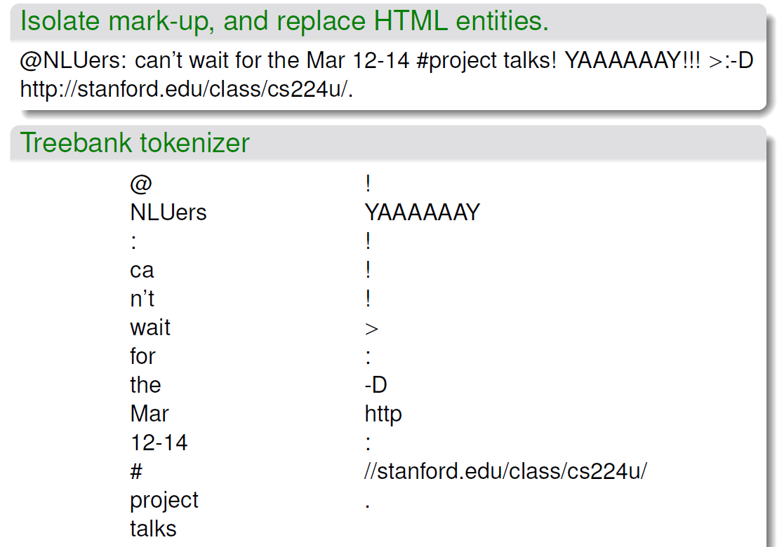
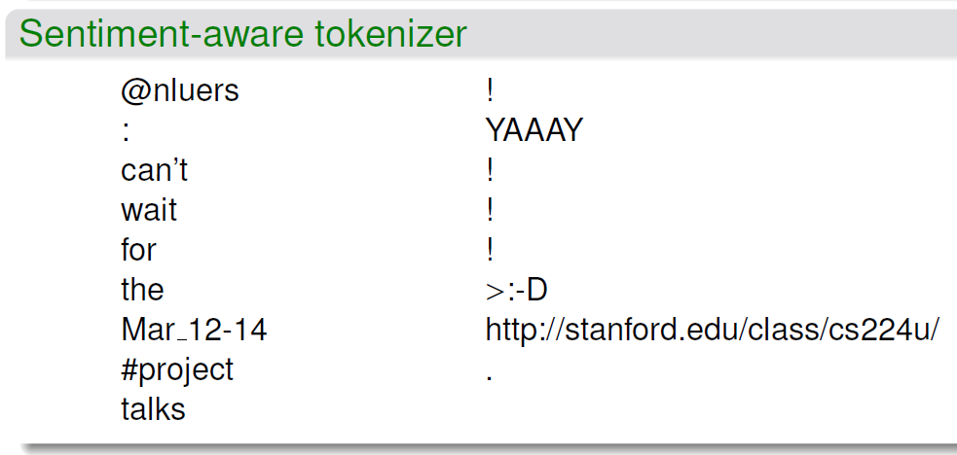
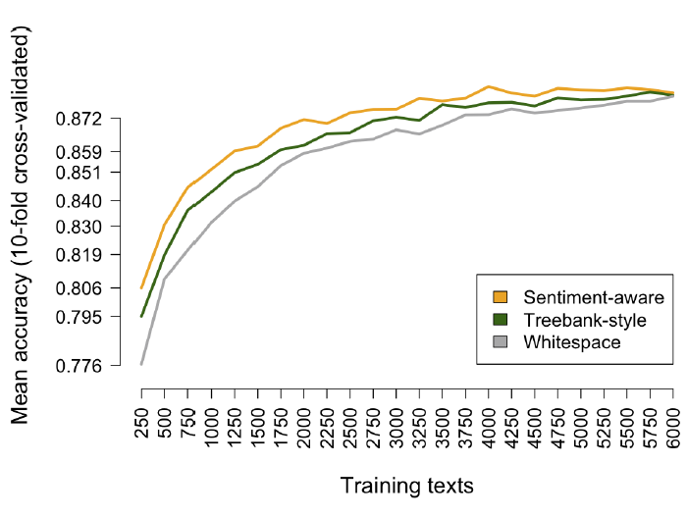
The importance of knowing your data: ex. tokenization
From Potts (2013), p. 22f.

Slide 35
Sentistrength: lexicon + social-web specifics + (optional) supervised learning of weights
a lexical approach that exploits a list of sentiment-related terms
PLUS rules to deal with standard linguistic and social web methods to express sentiment, such as
emoticons,
exaggerated punctuation and
deliberate misspellings.
“Supervised mode”: SentiStrength has the capability to optimise its lexicon term weights for a specific set of human-coded texts (i.e., a collection of texts with human-assigned sentiment scores for each one).
It does this by repeatedly increasing or decreasing the term weights by 1, one term at a time, and then assessing whether this change increases, decreases or does not affect the overall classification accuracy for the human coded texts.
Changes that improve accuracy are kept and the process is repeated until no term strength change improves the overall classification accuracy
Cited from Thelwall (2013)
Notes:
Thelwall, M. (2013). Heart and Soul: Sentiment Strength Detection in the Social Web with Sentistrength. In J. Holyst (Ed.), Cyberemotions (pp. 1–14).
http://sentistrength.wlv.ac.uk/documentation/SentiStrengthChapter.pdf

Slide 36
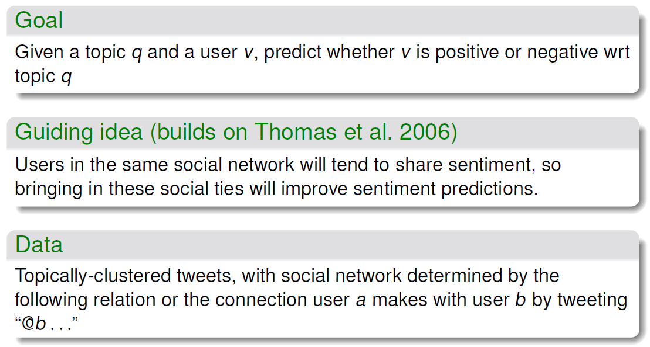
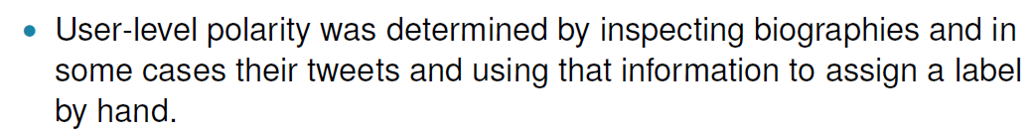
Sentiment is social (Tan et al., 2011)
From Potts (2013), pp. 83ff.

Slide 37
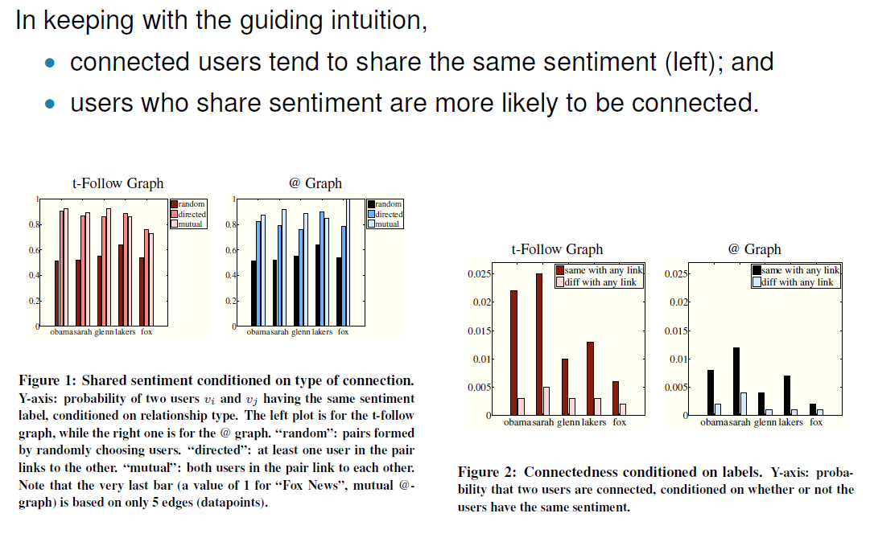
Tan et al. (2011): results
The authors also derived a predictive model for tweets and users sentiment
From Potts (2013), pp. 83ff.

Slide 38
Motivation and overview Major dimensions: Units of analysis, methods, features Issues in aspect-/sentence-oriented SA Social media: the case of tweets Evaluation Some challenges and current research directions

Slide 39
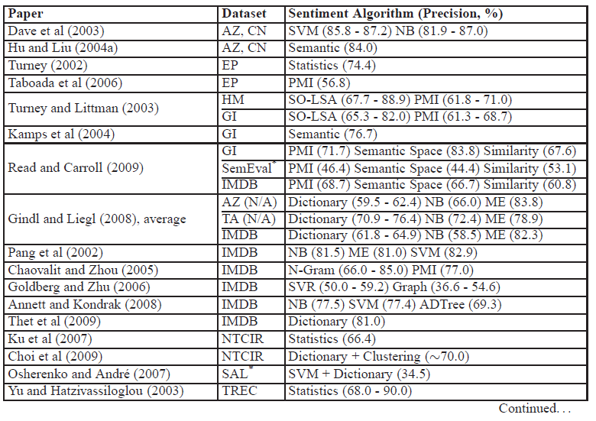
Performance overview (2012) (1)
From Tsytsarau & Palpanas (2012)

Slide 40
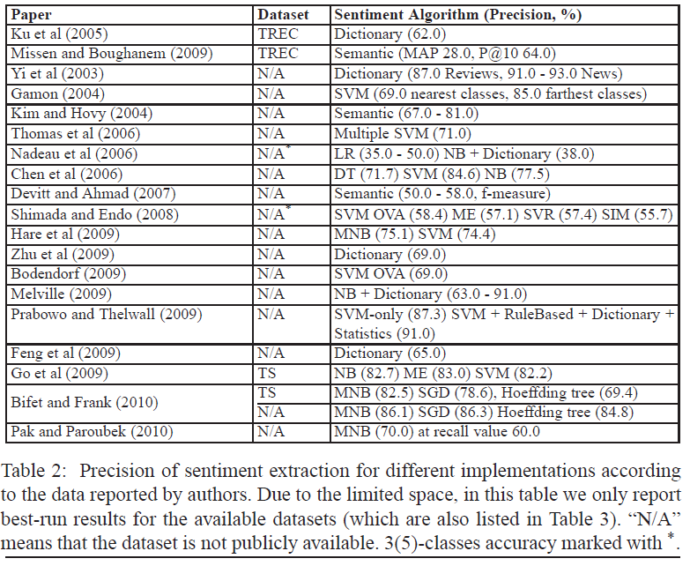
Performance overview (2012) (2)
From Tsytsarau & Palpanas (2012)

Slide 41
Motivation and overview Major dimensions: Units of analysis, methods, features Issues in aspect-/sentence-oriented SA Social media: the case of tweets Evaluation Some challenges and current research directions

Slide 42
Some challenges and current research directions The “ground truth“ The concept of opinion/sentiment Opinion detection – opinion creation

Slide 43
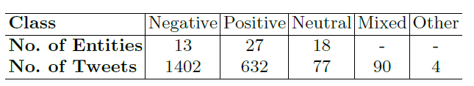
“Ground truth“ problems, esp. inter-rater reliability: ex. STS-Gold dataset, Saif et al. 2013)
2800 tweets selected to be about ≥ 1 of 28 entities, 200 tweets more added 32 more entities
3 raters agreed on only ~ 2000 of 3000 tweets
Krippendorff‘s alpha (along with recommendations):
.765 for tweet-level annotation ➔ tentative conclusions only
.416 entity-level for individual tweets ➔ discard
.964 entity-level aggregated ➔ good, but what does this mean?
How expressive are those labels anyway?
How constraining is a rater interface that only permits these labels?

Slide 44
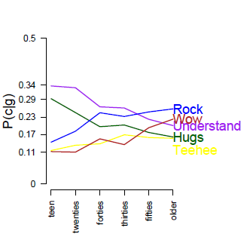
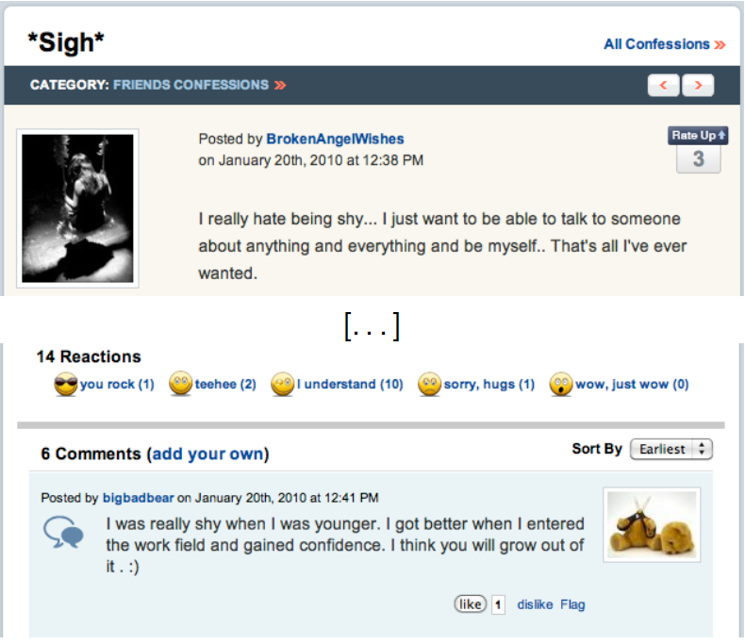
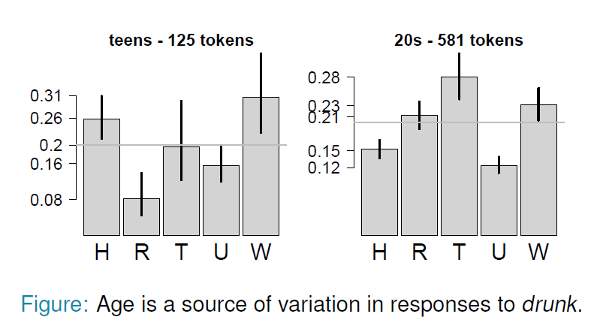
Reader-dependence of sentiment : ex. the Experience project (from Potts, 2013)
Notes:
http://www.experienceproject.com/
@MISC{Hsu_machinelearning, author = {Raymond Hsu and Bozhi See and Alan Wu}, title = {Machine Learning for Sentiment Analysis on the Experience Project}, year = {} }
http://citeseerx.ist.psu.edu/viewdoc/summary?doi=10.1.1.374.9949

Slide 45
Some challenges and current research directions The “ground truth“ The concept of opinion/sentiment Opinion detection – opinion creation

Slide 46

Is sentiment really but ?
neutral
“Headlong’s adaptation of George Orwell’s ‘Nineteen Eighty-Four’ is such a sense-overloadingly visceral experience that it was only the second time around, as it transfers to the West End, that I realised quite how political it was. Writer-directors […] have reconfigured Orwell’s plot, making it less about Stalinism, more about state-sponsored torture. Which makes great, queasy theatre, as Sam Crane’s frail Winston stumbles through 101 minutes of disorientating flashbacks, agonising reminisce, blinding lights, distorted roars, walls that explode in hails of sparks, […] and the almost-too-much-to-bear Room 101 section, which churns past like ‘The Prisoner’ relocated to Guantanamo Bay. […] Crane’s traumatised Winston lives in two strangely overlapping time zones – 1984 and an unspecified present day. The former, with its two-minute hate and its sexcrime and its Ministry of Love, clearly never happened. But the present day version, in which a shattered Winston groggily staggers through a 'normal' but entirely indifferent world, is plausible. Any individual who has crossed the state – and there are some obvious examples – could go through what Orwell’s Winston went through. Second time out, it feels like an angrier and more emotionally righteous play. Some weaknesses become more apparent second time too.”
positive
negative?
Neutral?
Notes:
http://www.timeout.com/london/theatre/1984-3

Slide 47
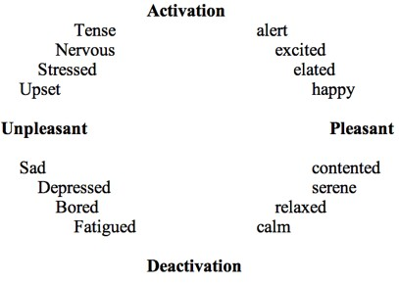
More than binary (example)
Notes:
Distress
https://en.wikipedia.org/wiki/File:Two_Dimensions_of_Emotion.gif.jpg

Slide 48
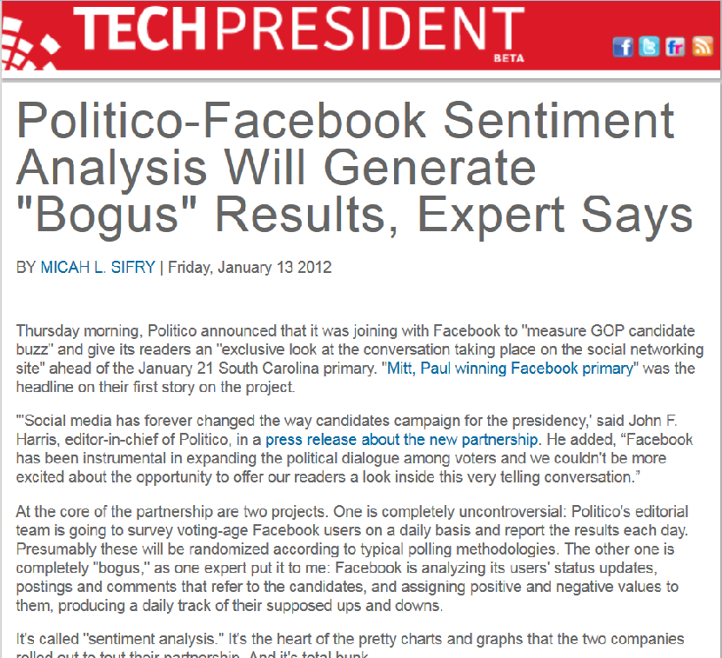
In politics
Someone who writes "I'm so happy that Newt Gingrich is staying in the race" might be a genuine Gingrich fan, or they might be someone who hates him, but likes that he's staying in the race because he's entertaining, or because they think he's hurting the Republican field.
➔ irony? sarcasm?
Notes:
http://techpresident.com/news/21618/politico-facebook-sentiment-analysis-bogus

Slide 49
What is an opinion?
“The fact is ...“ and similar expressions are highly correlated with subjectivity (Riloff and Wiebe, 2003)
opinion (əˈpɪnjən)
n
1. judgment or belief not founded on certainty or proof
...
3. evaluation, impression, or estimation of the value or worth of a person or thing
...
[via Old French from Latin opīniō belief, from opīnārī to think]
Collins English Dictionary – Complete and Unabridged 2003
Notes:
E. Riloff and J. Wiebe, “Learning extraction patterns for subjective expressions,”
in Proceedings of the Conference on Empirical Methods in Natural
Language Processing (EMNLP), 2003.

Slide 50
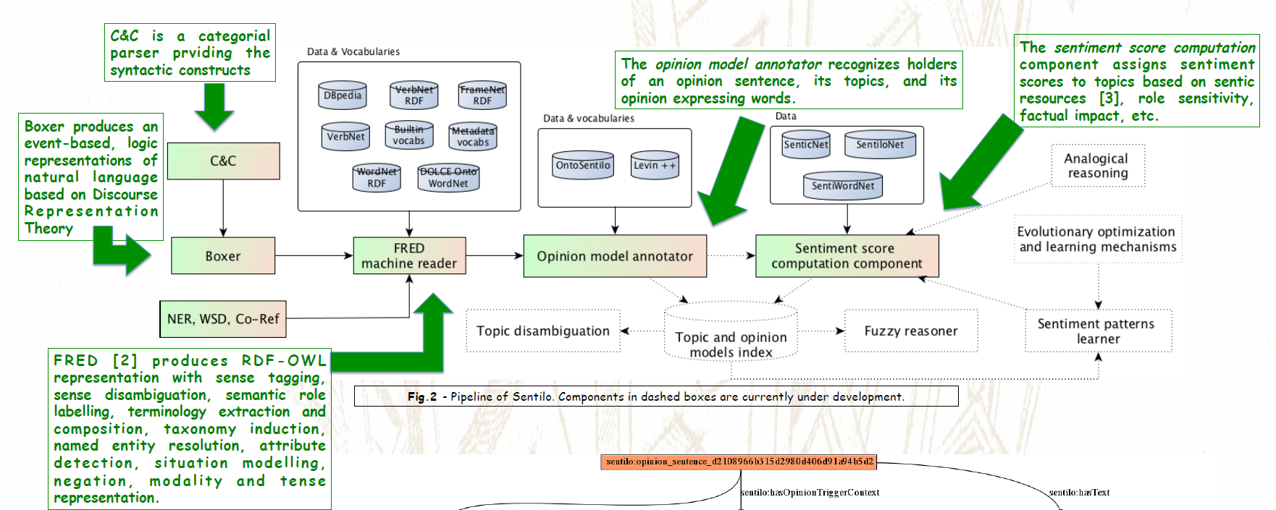
Sentilo – discourse analysis (+ more) (wit.istc.cnr.it/stlab-tools/sentilo; Gangemi et al., 2014; Reforgiato Recupero, 2014)

Slide 51
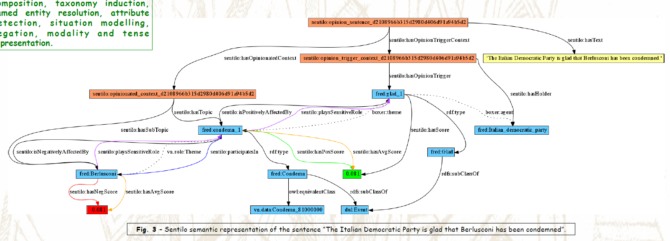
Sentilo – example

Slide 52
Some challenges and current research directions The “ground truth“ The concept of opinion/sentiment Opinion detection – opinion creation

Slide 53
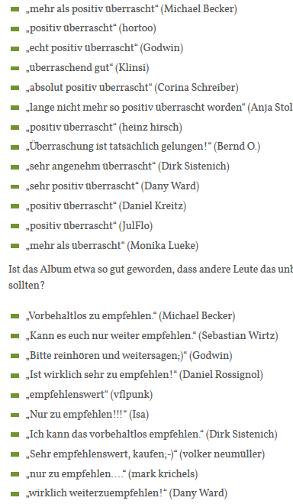
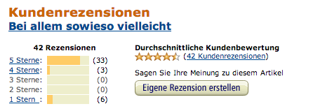
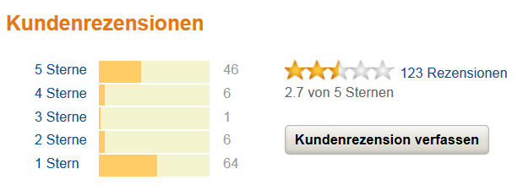
Veracity?
Methods for detecting opinion spam:
Ott et al. (2011); Jindal & Liu (2008)
Notes:
Nitin Jindal and Bing Liu. 2008. Opinion spam and analysis. In Proceedings of the 2008 International Conference on Web Search and Data Mining (WSDM '08). ACM, New York, NY, USA, 219-230. DOI=10.1145/1341531.1341560 http://doi.acm.org/10.1145/1341531.1341560
Myle Ott, Yejin Choi, Claire Cardie, and Jeffrey T. Hancock. 2011. Finding deceptive opinion spam by any stretch of the imagination. In Proceedings of the 49th Annual Meeting of the Association for Computational Linguistics: Human Language Technologies - Volume 1 (HLT '11), Vol. 1. Association for Computational Linguistics, Stroudsburg, PA, USA, 309-319.
http://www.stefan-niggemeier.de/blog/wp-content/beckmann_rezensionen.gif;
2.7: amazon.de, 20.5.2014
http://www.stefan-niggemeier.de/blog/wie-auf-amazon-ploetzlich-ganz-viele-leute-fuer-reinhold-beckmanns-musik-schwaermten/
14.3. release; 19.3. Niggemeyer; 20.5. Reaktionen ...

Slide 54
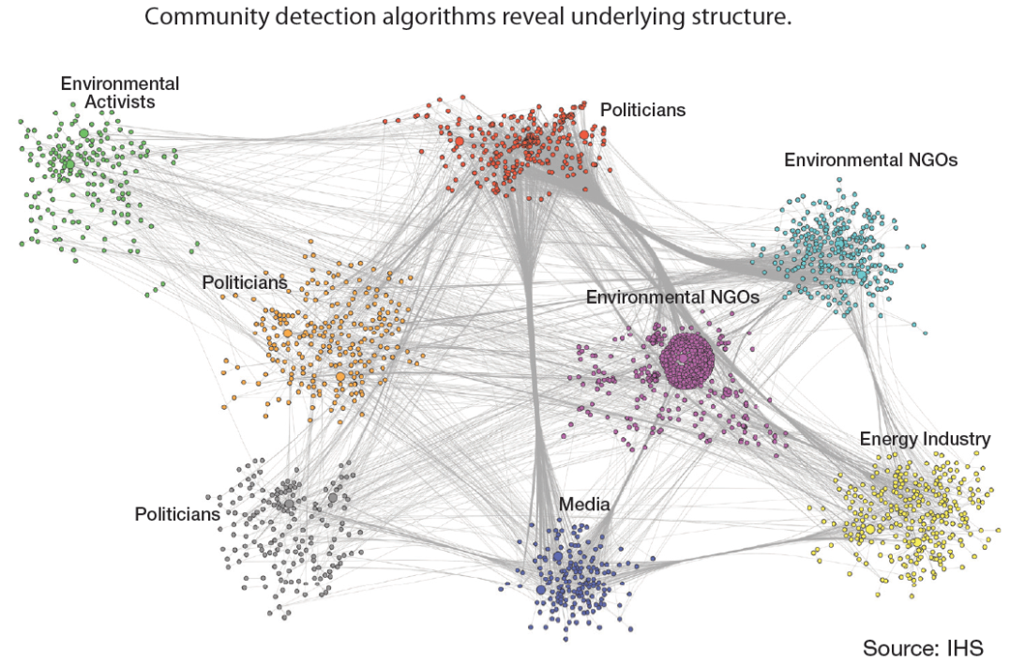
Aggregates: are opinions additive? “Sentiment Intelligence“ (case study from an IHS 2013 White Paper, gnip.com/docs/IHS-Sentiment-Intelligence-White-Paper.pdf)
“On 3 January 2013, Promised Land hit theaters across the United States. The theme of the movie was a small town’s reaction to “fracking” in its backyard. In the weeks running up to the release, several oil and gas drillers engaged in hydraulic fracturing grew nervous that public opinion would turn against them because of the movie’s anti-fracking message. They wanted to know what the fallout would be and what they needed to do to respond to make sure they could continue to extract natural gas.”
“The research revealed that to reach [virality] the number of followers an influencer has … is not nearly as important as whether those followers re-tweeted the influencer’s message outside that person’s cluster.”
Notes:
Information Handling Services, seit dem Jahr 2004 nur noch kurz IHS, ist ein weltweit tätiges Unternehmen für Analysen und Informationen mit Sitz in den USA.
URL des Reports fehlt

Slide 55


“Make the world safe for democracy“: the US CPI (1917-1918)
Notes:
http://upload.wikimedia.org/wikipedia/commons/4/4c/Liberty-shall-not-perish-Pennell.jpeg (Joseph Pennell)
http://en.wikipedia.org/wiki/File:%27Destroy_this_mad_brute%27_WWI_propaganda_poster_%28US_version%29.jpg

Slide 56
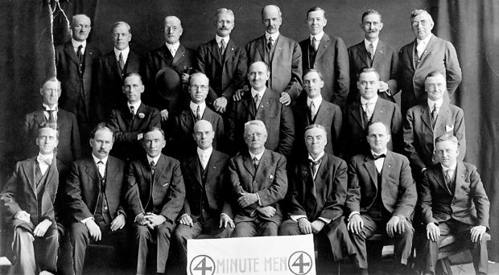
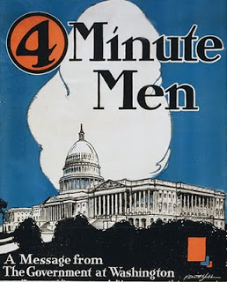

Going viral: CPI, OTF
“One idea – simple langugage – talk in pictures, not in statistics – touch their minds, hearts, spirits – make them want to win with every fiber of their beings – translate that desire into terms of bonds – and they will buy.“
Notes:
Committee on Public Information, an American governmental organization during World War I
http://bloximages.chicago2.vip.townnews.com/herald-review.com/content/tncms/assets/v3/editorial/8/d7/8d74e2fa-d21e-11e2-a492-001a4bcf887a/51b6558831273.preview-620.jpg
http://3.bp.blogspot.com/_BYW4anrHl_8/THAuGdsDFgI/AAAAAAAAArk/8lozVfaWqFU/s1600/four+minute+men+capitol+bldg.jpg
http://usarmy.vo.llnwd.net/e2/rv5_images/otf/comrel_button.jpg
Die Schulszene: http://usarmy.vo.llnwd.net/e2/c/images/2012/10/19/268623/size0.jpg

Slide 57
Thank you!
I‘ll be more than happy to hear your
s
?

Slide 58
(Some) Tools, including for general purposes of language processing
Ling Pipe
linguistic processing of text including entity extraction, clustering and classification, etc.
http://alias-i.com/lingpipe/
OpenNLP
the most common NLP tasks, such as POS tagging, named entity extraction, chunking and coreference resolution.
http://opennlp.apache.org/
Stanford Parser and Part-of-Speech (POS) Tagger
http://nlp.stanford.edu/software/tagger.shtm/
NTLK
Toolkit for teaching and researching classification, clustering and parsing
http://www.nltk.org/
OpinionFinder
subjective sentences , source (holder) of the subjectivity and words that are included in phrases expressing positive or negative sentiments.
http://code.google.com/p/opinionfinder/
Basic sentiment tokenizer plus some tools, by Christopher Potts
http://sentiment.christopherpotts.net
Twitter NLP and Part-of-speech tagging
http://www.ark.cs.cmu.edu/TweetNLP/
Notes:
Add

Slide 59
Tools directly for sentiment analysis
SentiStrength (sentistrength.wlv.ac.uk)
TheySay (apidemo.theysay.io)
Sentic (sentic.net/demo)
Sentdex (sentdex.com)
Lexalytics (lexalytics.com)
Sentilo (wit.istc.cnr.it/stlab-tools/sentilo)
nlp.stanford.edu/sentiment

Slide 60
Lexicons
Bing Liu‘s opinion lexicon
http://www.cs.uic.edu/~liub/FBS/sentiment-analysis.html
MPQA subjectivity lexicon
http://www.cs.pitt.edu/mpqa/
SentiWordNet
Project homepage: http://sentiwordnet.isti.cnr.it
Python/NLTK interface: http://compprag.christopherpotts.net/wordnet.html
Harvard General Inquirer
http://www.wjh.harvard.edu/~inquirer/
Disagree on some-to-many words (see Potts, 2013)
SenticNet
http://sentic.net

Slide 61
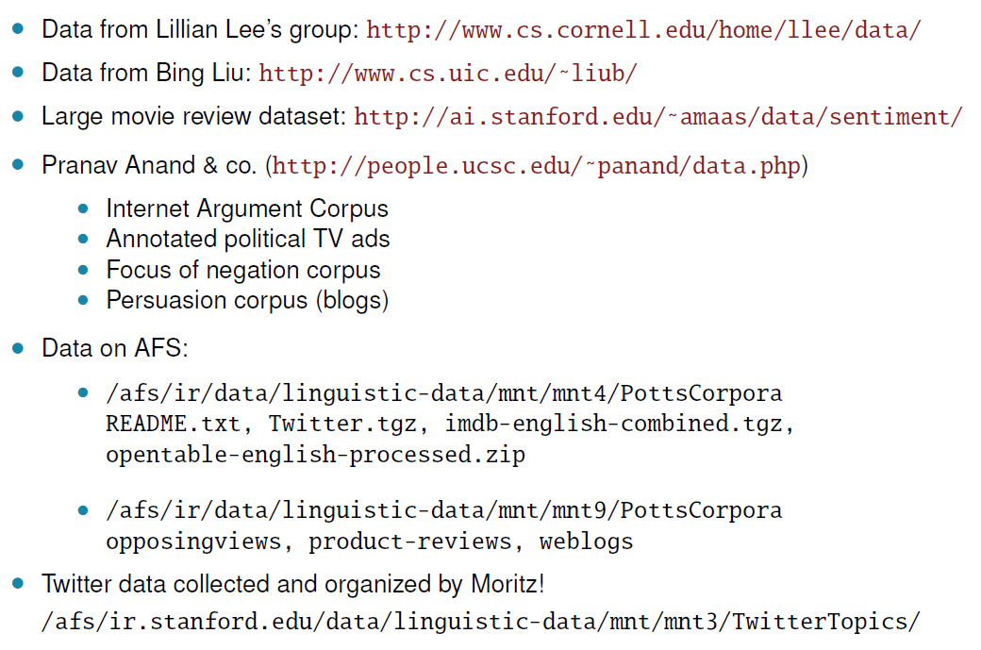
(Some) datasets
From Potts (2013), p.5
More on Twitter datasets, including critical appraisal: Saif et al. (2013)
Notes:
Potts (2013). Introduction to Sentiment Analysis. http://www.stanford.edu/class/cs224u/slides/2013/cs224u-slides-02-26.pdf
Saif, H., Fernandez, M., He, Y. and Alani, H. (2013) Evaluation Datasets for Twitter Sentiment Analysis: A survey and a new dataset, the STS-Gold, Workshop: Emotion and Sentiment in Social and Expressive Media: approaches and perspectives from AI (ESSEM) at AI*IA Conference, Turin, Italy

Slide 62
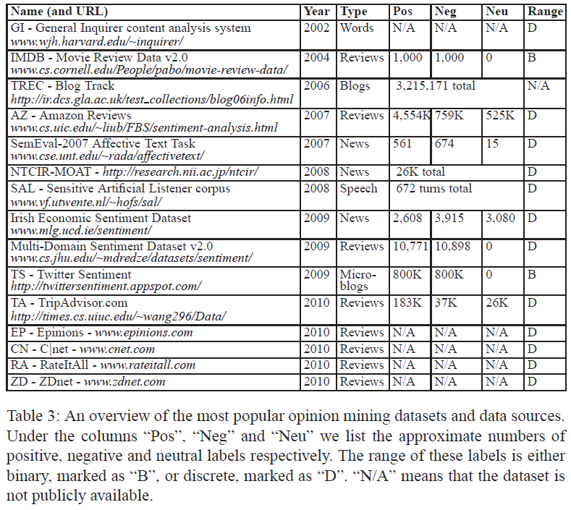
More datasets
From Tsytsarau & Palpanas (2012)

Slide 63
More datasets
SNAP review datasets: http://snap.stanford.edu/data/
Yelp dataset: http://www.yelp.com/dataset_challenge/
User intentions in image capturing a dataset going beyond text
Contributed by Desara Xhura – thanks!
http://www.itec.uni-klu.ac.at/~mlux/wiki/doku.php?id=research:photointentionsdata
Papers on this project: http://www.itec.uni-klu.ac.at/~mlux/wiki/doku.php?id=start

Slide 64
Surveys used for this presentation
Ronen Feldman: Techniques and applications for sentiment analysis. Commun. ACM 56(4): 82-89 (2013).
Bing Liu, Lei Zhang: A Survey of Opinion Mining and Sentiment Analysis. Mining Text Data 2012: 415-463.
Bo Pang, Lillian Lee: Opinion Mining and Sentiment Analysis. Foundations and Trends in Information Retrieval 2(1-2): 1-135 (2007).
Potts (2013). Introduction to Sentiment Analysis. http://www.stanford.edu/class/cs224u/slides/2013/cs224u-slides-02-26.pdf
Mikalai Tsytsarau, Themis Palpanas: Survey on mining subjective data on the web. Data Min. Knowl. Discov. 24(3): 478-514 (2012)
My summary of these (an earlier and longer version of the present slides): Berendt, B. (2014). Opinion mining, sentiment analysis, and beyond. Lecture at the Summer School Foundations and Applications of Social Network Analysis & Mining, June 2-6, 2014, Athens, Greece. http://people.cs.kuleuven.be/~bettina.berendt/Talks/berendt_opinion_mining_summerschool_2014.pptx

Slide 65
Other references
Carenini, G., R. Ng, and E. Zwart. Extracting knowledge from evaluative text. In Proceedings of Third Intl. Conf. on Knowledge Capture (K-CAP-05), 2005.
Ding, X. and B. Liu. Resolving object and attribute coreference in opinion mining. In Proceedings of International Conference on Computational Linguistics (COLING-2010), 2010.
Reforgiato Recupero, D., Presutti, V., Consoli, S., Gangemi, A., & Nuzzolese, A.G. (2014). Sentilo: Frame-based Sentiment Analysis. Cognitive Computation, 7(2):211-225.
Gangemi, A., Presutti, V., & Reforgiato Recupero, D. (2014). Frame-Based Detection of Opinion Holders and Topics: A Model and a Tool. IEEE Comp. Int. Mag. 9(1): 20-30.
Nitin Jindal and Bing Liu. 2008. Opinion spam and analysis. In Proceedings of the 2008 International Conference on Web Search and Data Mining (WSDM '08). ACM, New York, NY, USA, 219-230.
R. Mihalcea, C. Banea, and J. Wiebe, “Learning multilingual subjective language via cross-lingual projections,” in Proceedings of the Association for Computational Linguistics (ACL), pp. 976–983, Prague, Czech Republic, June 2007.
Mihalcea, R. & Liu, H. (2006). A Corpus-based Approach to Finding Happiness In Proc. AAAI Spring Symposium CAAW. http://www.cse.unt.edu/~rada/papers/mihalcea.aaaiss06.pdf
Myle Ott, Yejin Choi, Claire Cardie, and Jeffrey T. Hancock. 2011. Finding deceptive opinion spam by any stretch of the imagination. In Proceedings of the 49th Annual Meeting of the Association for Computational Linguistics: Human Language Technologies - Volume 1 (HLT '11), Vol. 1. Association for Computational Linguistics, Stroudsburg, PA, USA, 309-319.
Popescu, A. and O. Etzioni. Extracting product features and opinions from reviews. In Proceedings of Conference on Empirical Methods in Natural Language Processing (EMNLP-2005), 2005.
Qiu, G., B. Liu, J. Bu, and C. Chen. Expanding domain sentiment lexicon through double propagation. In Proceedings of International Joint Conference on Articial Intelligence (IJCAI-2009), 2009.
Qiu, G., B. Liu, J. Bu, and C. Chen. Opinion word expansion and target extraction through double propagation. Computational Linguistics, 2011.
E. Riloff and J. Wiebe, “Learning extraction patterns for subjective expressions,” in Proceedings of the Conference on Empirical Methods in Natural Language Processing (EMNLP), 2003.
Saif, H., Fernandez, M., He, Y. and Alani, H. (2013) Evaluation Datasets for Twitter Sentiment Analysis: A survey and a new dataset, the STS-Gold, Workshop: Emotion and Sentiment in Social and Expressive Media: approaches and perspectives from AI (ESSEM) at AI*IA Conference, Turin, Italy.
Saif, H., Fernandez, M., He, Y. and Alani, H. (2014) SentiCircles for Contextual and Conceptual Semantic Sentiment Analysis of Twitter, 11th Extended Semantic Web Conference, Crete, Greece.
Tan, C., Lee, L., Tang, J., Jiang, L., Zhou, M., & Li, P. (2011). User-level sentiment analysis incorporating social networks. In Proc. 17th SIGKDD Conference (1397-1405). San Diego, CA: ACM Digital Library.
Thelwall, M. (2013). Heart and Soul: Sentiment Strength Detection in the Social Web with Sentistrength. In J. Holyst (Ed.), Cyberemotions (pp. 1–14).
http://sentistrength.wlv.ac.uk/documentation/SentiStrengthChapter.pdf
J. M. Wiebe, T. Wilson, R. Bruce, M. Bell, and M. Martin, “Learning subjective language,” Computational Linguistics, vol. 30, pp. 277–308, September 2004.
H. Yu and V. Hatzivassiloglou, “Towards answering opinion questions: Separating facts from opinions and identifying the polarity of opinion sentences,” in Proceedings of the Conference on Empirical Methods in Natural Language Processing (EMNLP), 2003.

Slide 66
More sources
Please find the URLs of pictures and screenshots in the Powerpoint “comment“ box
Thanks to the Internet for them!

